Slide 1




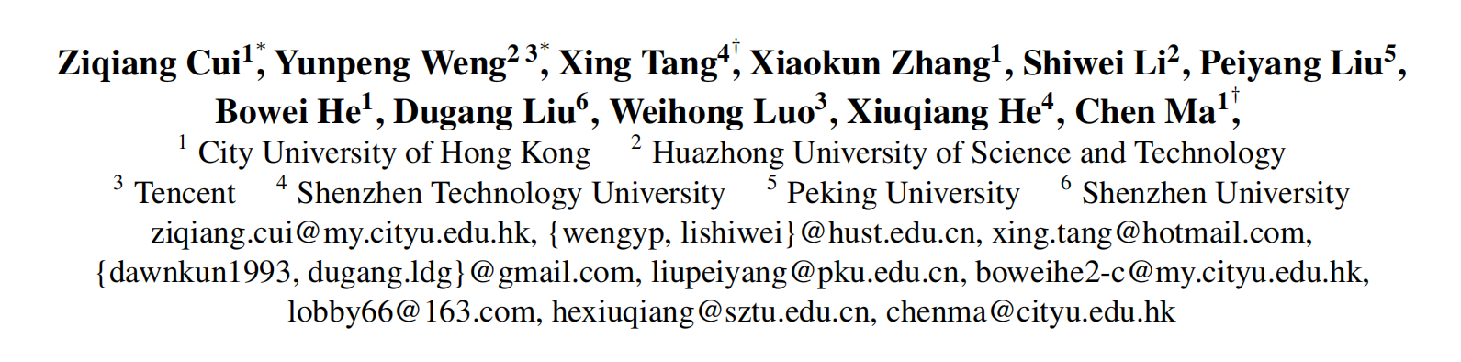





ATAI
Advanced Technique of Artificial Intelligence
ATAI
ChongqingUniversity _{AdvancedTechniqueof}
of Technology Artificial Intelligence
Chongqing University of
Technology
Chongqing University ^{ATAI}
_{of Technology} Advanced Techniqueof
Artificial Intelligence
Chongqing University of Technology
Chongqing University of Technology
Semantic Retrieval Augmented Contrastive Learning
for Sequential Recommendation
Code: https://github.com/ziqiangcui/SRA-CL
—NeurIPS 2025
Reported by Cong Sheng
1

Slide 2
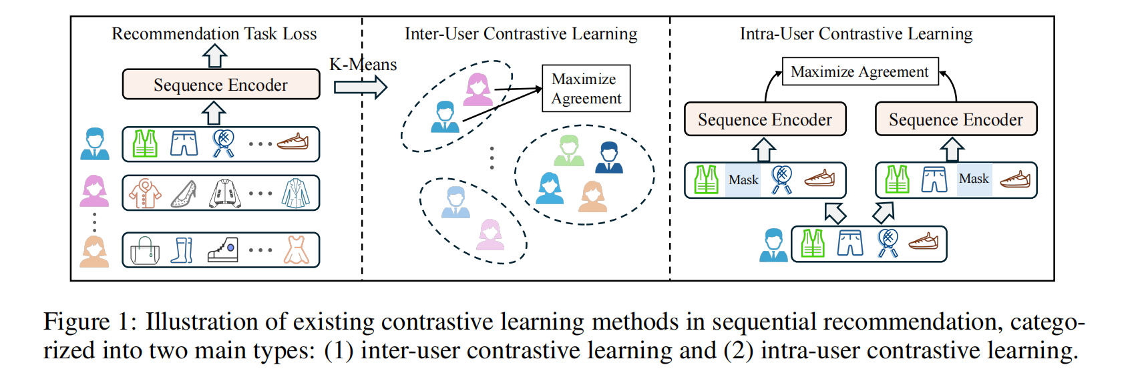
ATAI
Advanced Technique of Artificial Intelligence
ATAI
ChongqingUniversity _{AdvancedTechniqueof}
of Technology Artificial Intelligence
Chongqing University of
Technology
Chongqing University ^{ATAI}
_{of Technology} Advanced Techniqueof
Artificial Intelligence
Chongqing University of Technology
Chongqing University of Technology
Motivation
Difficulties generating high-quality contrastive pairs:
1) Existing methods either rely on random perturbations that corrupt user preference patterns or depend on sparse collaborative data that generates unreliable contrastive pairs.
2)Existing approaches typically require predefined selection rules that impose strong assumptions, limiting the model’s ability to autonomously learn optimal contrastive pairs.

Slide 3
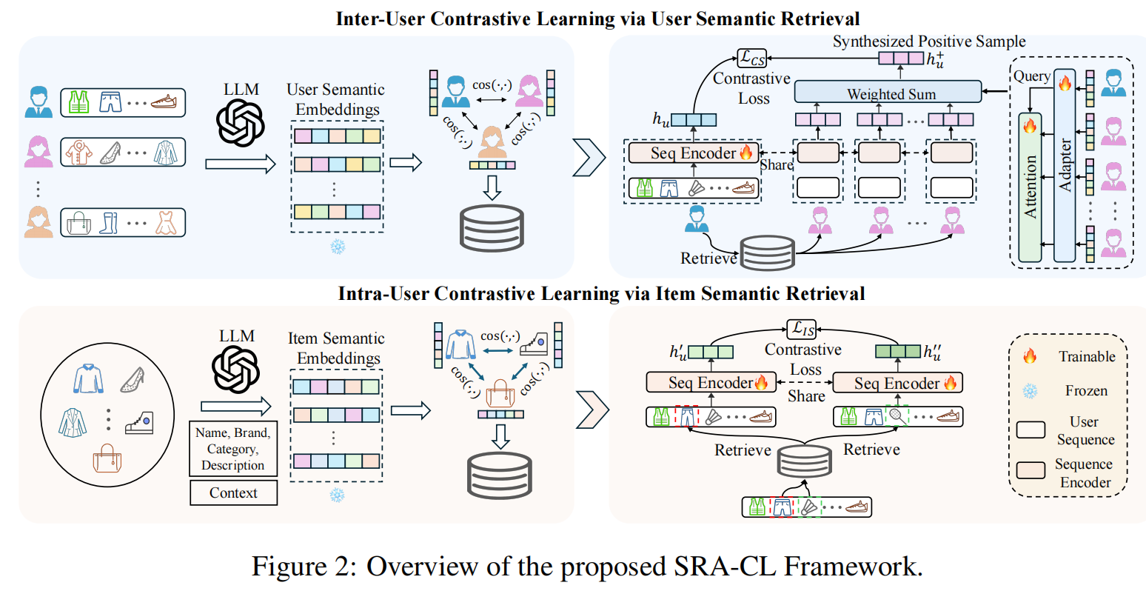
ATAI
Advanced Technique of Artificial Intelligence
ATAI
ChongqingUniversity _{AdvancedTechniqueof}
of Technology Artificial Intelligence
Chongqing University of
Technology
Chongqing University ^{ATAI}
_{of Technology} Advanced Techniqueof
Artificial Intelligence
Chongqing University of Technology
Chongqing University of Technology
Overview

Slide 4
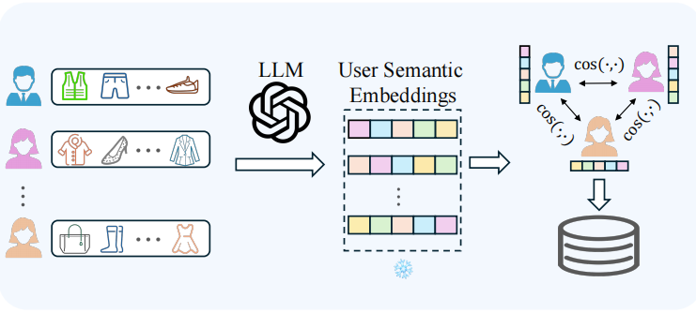
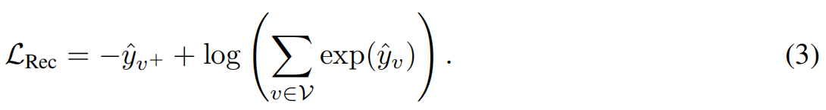
ATAI
Advanced Technique of Artificial Intelligence
ATAI
ChongqingUniversity _{AdvancedTechniqueof}
of Technology Artificial Intelligence
Chongqing University of
Technology
Chongqing University ^{ATAI}
_{of Technology} Advanced Techniqueof
Artificial Intelligence
Chongqing University of Technology
Chongqing University of Technology
Method

Slide 5
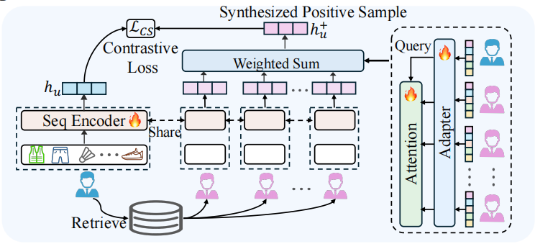
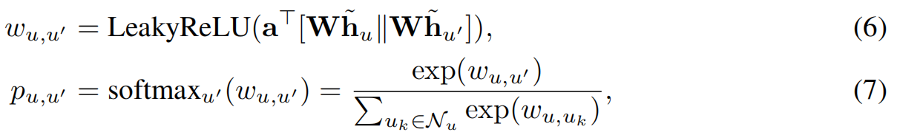
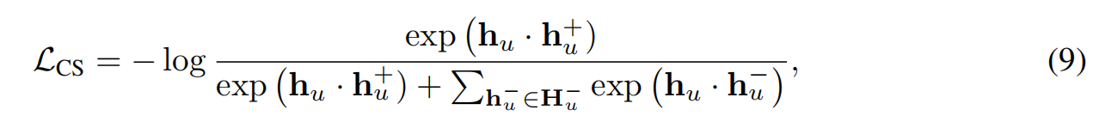
ATAI
Advanced Technique of Artificial Intelligence
ATAI
ChongqingUniversity _{AdvancedTechniqueof}
of Technology Artificial Intelligence
Chongqing University of
Technology
Chongqing University ^{ATAI}
_{of Technology} Advanced Techniqueof
Artificial Intelligence
Chongqing University of Technology
Chongqing University of Technology
Method

Slide 6
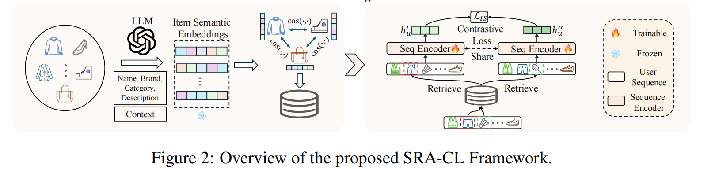
ATAI
Advanced Technique of Artificial Intelligence
ATAI
ChongqingUniversity _{AdvancedTechniqueof}
of Technology Artificial Intelligence
Chongqing University of
Technology
Chongqing University ^{ATAI}
_{of Technology} Advanced Techniqueof
Artificial Intelligence
Chongqing University of Technology
Chongqing University of Technology
Method

Slide 7
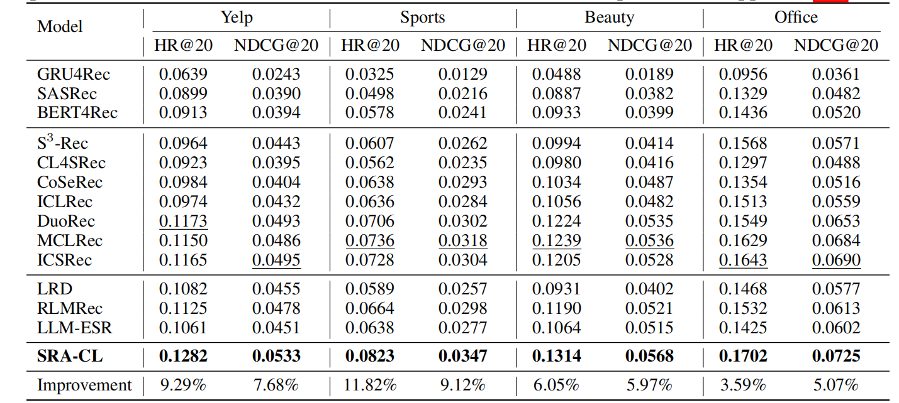
ATAI
Advanced Technique of Artificial Intelligence
ATAI
ChongqingUniversity _{AdvancedTechniqueof}
of Technology Artificial Intelligence
Chongqing University of
Technology
Chongqing University ^{ATAI}
_{of Technology} Advanced Techniqueof
Artificial Intelligence
Chongqing University of Technology
Chongqing University of Technology
Experiments
0.1311 0.0564
0.1678 0.0719

Slide 8
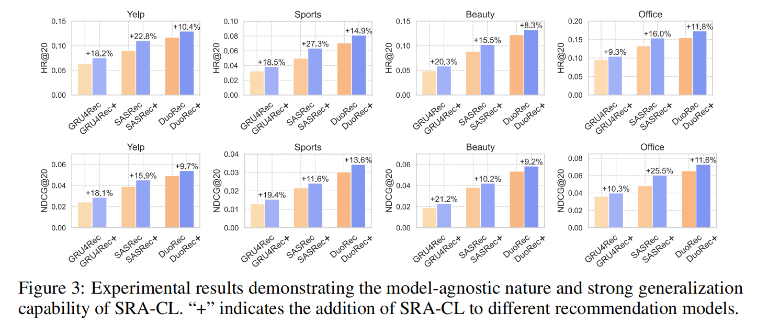
ATAI
Advanced Technique of Artificial Intelligence
ATAI
ChongqingUniversity _{AdvancedTechniqueof}
of Technology Artificial Intelligence
Chongqing University of
Technology
Chongqing University ^{ATAI}
_{of Technology} Advanced Techniqueof
Artificial Intelligence
Chongqing University of Technology
Chongqing University of Technology
Experiments

Slide 9

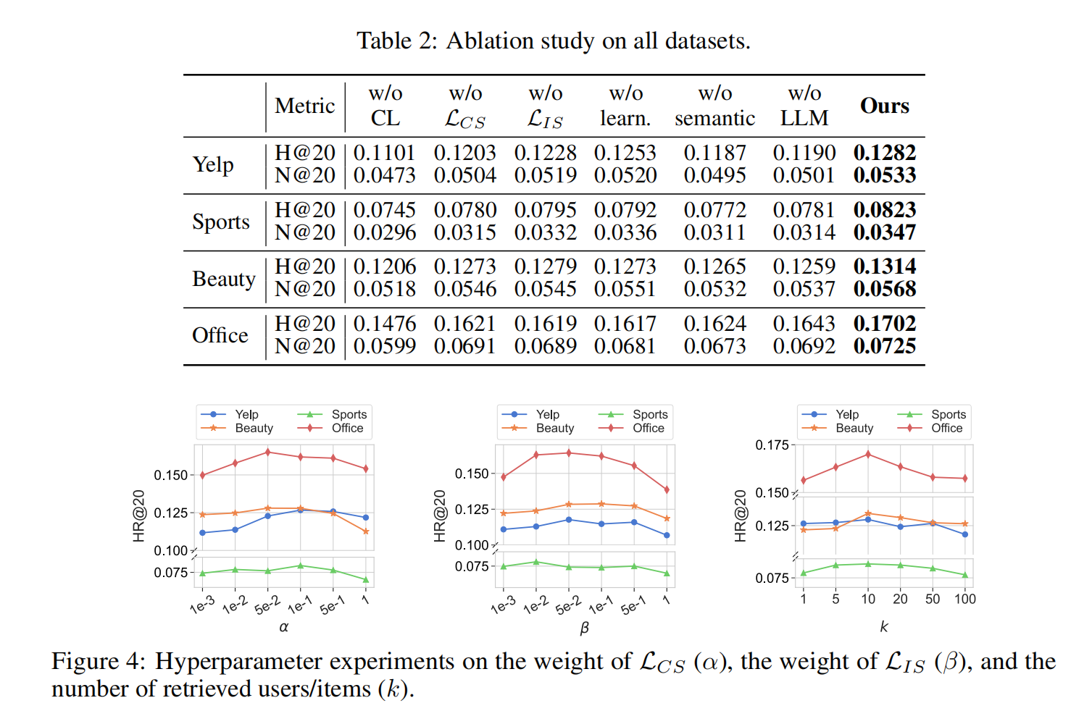
ATAI
Advanced Technique of Artificial Intelligence
ATAI
ChongqingUniversity _{AdvancedTechniqueof}
of Technology Artificial Intelligence
Chongqing University of
Technology
Chongqing University ^{ATAI}
_{of Technology} Advanced Techniqueof
Artificial Intelligence
Chongqing University of Technology
Chongqing University of Technology

Slide 10


ATAI
Advanced Technique of Artificial Intelligence
ATAI
ChongqingUniversity _{AdvancedTechniqueof}
of Technology Artificial Intelligence
Chongqing University of
Technology
Chongqing University ^{ATAI}
_{of Technology} Advanced Techniqueof
Artificial Intelligence
Chongqing University of Technology
Chongqing University of Technology
Thanks!

